Slide 1
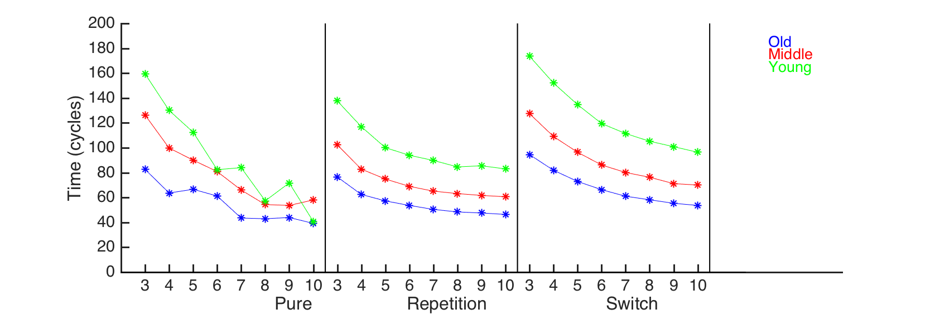
Pure
Repetition
Switch

Slide 2
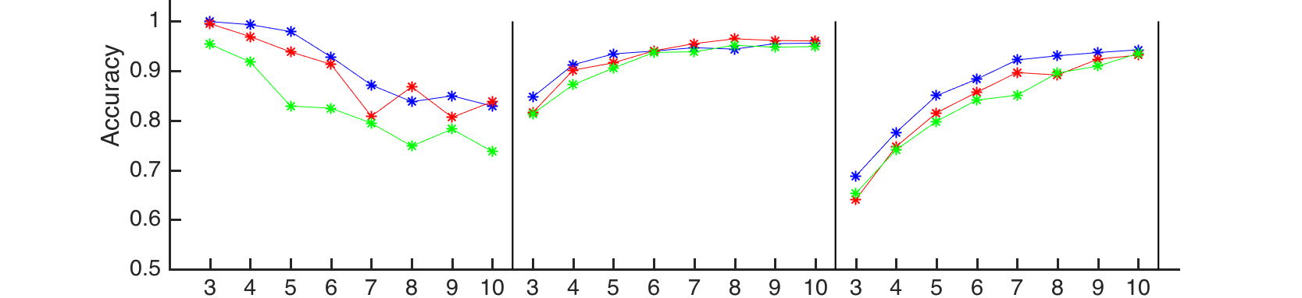
Pure
Repetition
Switch

Slide 3
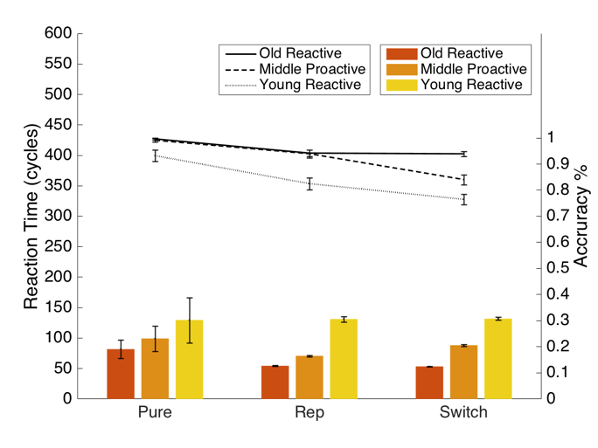
Model 3C

